Slide 1
Distributed Query Processing
Chapter 6
Overview of Query Processing
Chapter 7
Query Decomposition and Data
Localization
Notes:
1

Slide 2
Outline
Overview of Query Processing
Query Decomposition and Localization

Slide 3
Query Processing
High level user query
Query
Processor
Low level data manipulation commands

Slide 4
Query Processing Components
Query language that is used
  SQL (Structured Query Language)
Query execution methodology
  The steps that the system goes through in executing high-level (declarative) user queries
Query optimization
  How to determine the “best” execution plan?

Slide 5
Query Language
Tuple calculus: { t | F(t) }
  where t is a tuple variable, and F(t) is a well formed formula
Example:
  Get the numbers and names of all managers.

Slide 6
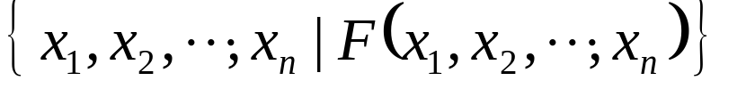

Query Language (cont.)
Domain calculus:
  where x_{i} is a domain variable, and is a well formed formula
Example:
  { x, y | EMP(x, y, “Manager") }
Variables are position sensitive!

Slide 7
Query Language (cont.)
SQL is a tuple calculus language.
  SELECT ENO,ENAME
  FROM EMP
  WHERE TITLE=“Programmer”
End user uses non-procedural (declarative) languages to express queries.

Slide 8
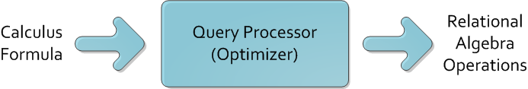
Query Processing Objectives & Problems
Query processor transforms queries into procedural operations to access data in an optimal way.
Distributed query processor has to deal with query decomposition and data localization.

Slide 9
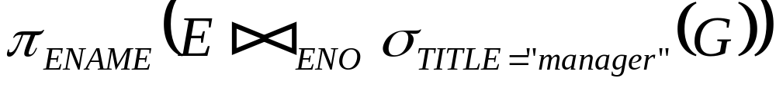
Centralized Query Processing Alternatives
SELECT ENAME
FROM EMP E, ASG G
WHERE E.ENO = G.ENO AND TITLE=“manager”
Strategy 2 avoids Cartesian product, so is “better”.
Strategy 1:
Strategy 2:

Slide 10
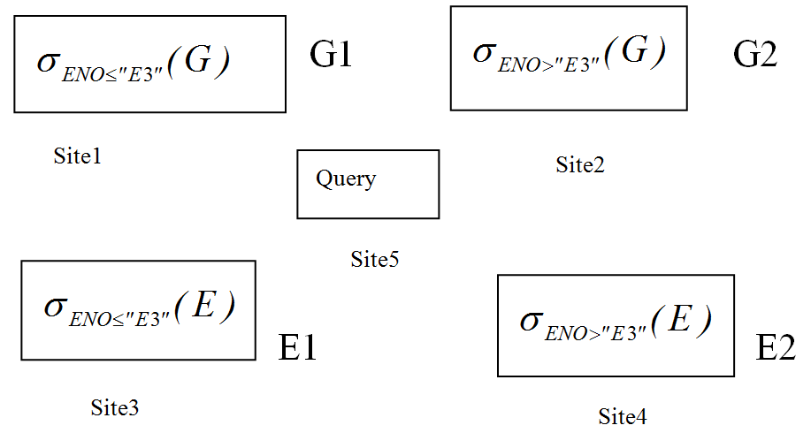
Distributed Query Processing
Query processor must consider the communication cost and select the best site.
The same query example, but relation G and E are fragmented and distributed.

Slide 11
Distributed Query Processing Plans
By centralized optimization,
Two distributed query processing plans

Slide 12
Distributed Query Plan I
  Plan I: To transport all segments to query site and
  execute there.
    This causes too much network traffic, very costly.
Site 5
⋈
Result = (EMP₁ ∪ EMP₂) _{ENO} σ_{TITLE=“manager”} (ASG₁ ∪ ASG₂)
ASG₁
ASG₂
EMP₁
EMP₂
Site 1
Site 2
Site 3
Site 4

Slide 13
Distributed Query Plan II
  Plan II (Optimized):
Site 5
Result = (EMP₁ ’ ∪ EMP₂ ’)
EMP₁’
EMP₂’
Site 3
Site 4
⋈
⋈
EMP₁’ = EMP_{1 ENO} ASG₁’
EMP₂’ = EMP_{2 ENO} ASG₂’
ASG₁’
ASG₂’
Site 1
Site 2
ASG₁’ = σ _{TITLE=“manager”} (ASG₁)
ASG₂’ = σ _{TITLE=“manager”} (ASG₂)

Slide 14
Costs of the Two Plans
Assume:
  size(EMP)=400, size(ASG)=1000, 20 tuples with TITLE=“manager”
  tuple access cost = 1 unit; tuple transfer cost = 10 units
  ASG and EMP are locally clustered on attribute TITLE and ENO, respectively.
Plan 1
  Transfer EMP to site 5: 400*tuple transfer cost 4000
  Transfer ASG to site 5: 1000*tuple transfer cost 10000
  Produce ASG’: 1000*tuple access cost 1000
  Join EMP and ASG’: 400*20*tuple access cost 8000
  Total cost 23,000
Plan 2
  Produce ASG’: (10+10)*tuple access cost 20
  Transfer ASG’ to the sites of EMP: (10+10)*tuple transfer cost 200
  Produce EMP’: (10+10)*tuple access cost * 2 40
  Transfer EMP’ to result site: (10+10)*tuple transfer cost 200
  Total cost 460

Slide 15
Query Optimization Objectives
Minimize a cost function
  I/O cost + CPU cost + communication cost
  These might have different weights in different distributed environments

Slide 16
Communication Cost
Wide area network
  Communication cost will dominate
    Low bandwidth
    Low speed
    High protocol overhead
  Most algorithms ignore all other cost components
Local area network
  Communication cost not that dominate
  Total cost function should be considered

Slide 17
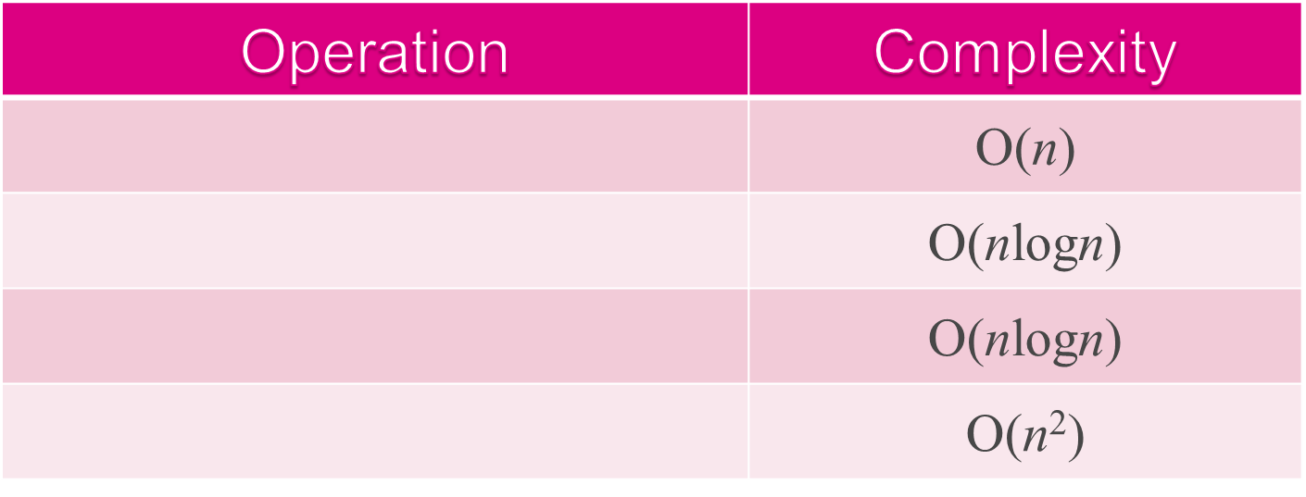

Complexity of Relational Algebra Operations
Measured by cardinality n and tuples are sorted on comparison attributes
σ
,
π
(without
duplicate
eliminatio
n)
π
(with
duplicate
eliminatio
n),
GROUP
Cartesian-Product X

Slide 18

Types of Query Optimization
Exhaustive search
  Cost-based
  Optimal
  Combinatorial complexity in the number of relations
  Workable for small solution spaces
Heuristics
  Not optimal
  Re-group common sub-expressions
  Perform selection and projection ( ) first
  Replace a join by a series of semijoins
  Reorder operations to reduce intermediate relation size
  Optimize individual operations

Slide 19
Query Optimization Granularity
Single query at a time
  Cannot use common intermediate results
Multiple queries at a time
  Efficient if many similar queries
  Decision space is much larger

Slide 20
Query Optimization Timing
Static
  Do it at compilation time by using statistics, appropriate for exhaustive search, optimized once, but executed many times.
  Difficult to estimate the size of the intermediate results
  Can amortize over many executions
Dynamic
  Do it at execution time, accurate about the size of the intermediate results, repeated for every execution, expensive.

Slide 21
Query Optimization Timing (cont.)
Hybrid
  Compile using a static algorithm
  If the error in estimate size > threshold, re-optimizing at run time

Slide 22
Statistics
Relation
  Cardinality
  Size of a tuple
  Fraction of tuples participating in a join with another relation
Attributes
  Cardinality of the domain
  Actual number of distinct values
Common assumptions
  Independence between different attribute values
  Uniform distribution of attribute values within their domain

Slide 23
Decision Sites
For query optimization, it may be done by
  Single site – centralized approach
    Single site determines the best schedule
    Simple
    Need knowledge about the entire distributed database
  All the sites involved – distributed approach
    Cooperation among sites to determine the schedule
    Need only local information
    Cost of operation
  Hybrid – one site makes major decision in cooperation with other sites making local decisions
    One site determines the global schedule
    Each site optimizes the local subqueries

Slide 24
Network Topology
Wide Area Network (WAN) – point-to-point
  Characteristics
    Low bandwidth
    Low speed
    High protocol overhead
  Communication cost will dominate; ignore all other cost factors
  Global schedule to minimize communication cost
  Local schedules according to centralized query optimization

Slide 25
Network Topology (cont.)
Local Area Network (LAN)
  communication cost not that dominate
  Total cost function should be considered
  Broadcasting can be exploited
  Special algorithms exist for star networks

Slide 26
Other Information to Exploit
Using replications to minimize communication costs
Using semijoins to reduce the size of operand relations to cut down communication costs when overhead is not significant.

Slide 27
Layers of Query Processing
Calculus Query on Distributed Relations
QUERY DECOMPOSITION
GLOBAL
SCHEMA
Algebra Query on Distributed Relations
CONTROL
SITE
DATA LOCALIZATION
FRAGMENT
SCHEMA
Fragment Query
GLOBAL OPTIMIZATION
STATISTICS ON
FRAGMENTS
Optimized Fragment Query
With Communication Operations
LOCAL
SITE
LOCAL OPTIMIZATION
LOCAL
SCHEMA
Optimized Local Queries

Slide 28
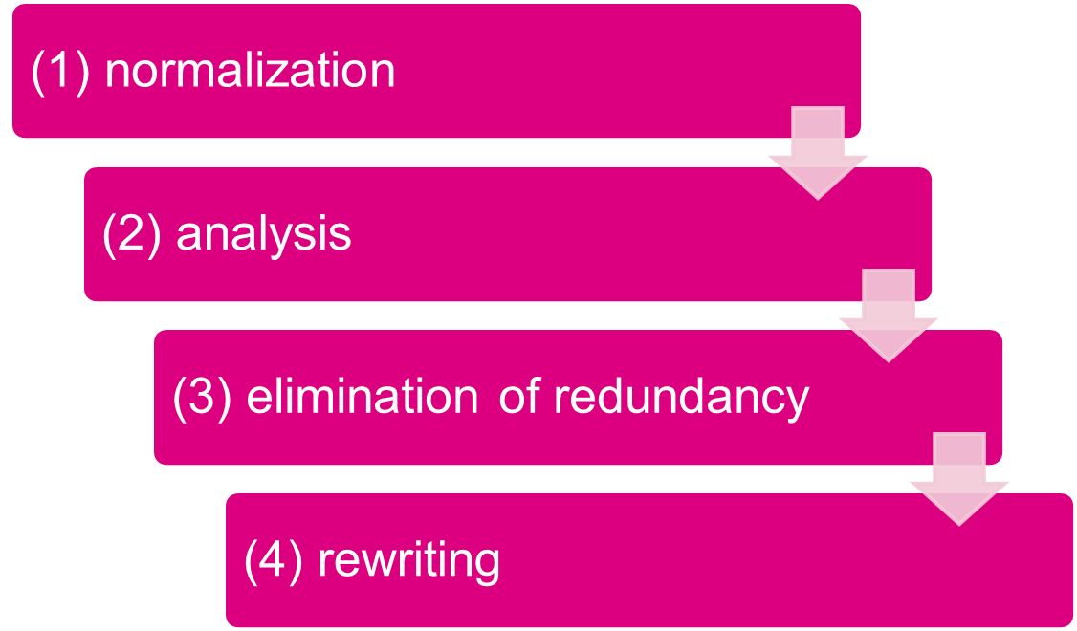
Step 1 - Query Decomposition
Decompose calculus query into algebra query using global conceptual schema information.

Slide 29
Step 1 - Query Decomposition (cont.)
1) Normalization
  The calculus query is written in a normalized form (CNF or DNF) for subsequent manipulation
2) Analysis
  To reject normalized queries for which further processing is either impossible or unnecessary (type incorrect or semantically incorrect)
3) Simplification
  Redundant predicates are eliminated to obtain simplified queries
4) Restructuring
  The calculus query is translated to optimal algebraic query representation
  More than one translation is possible

Slide 30
1) Normalization
Lexical and syntactic analysis
  check validity (similar to compilers)
  check for attributes and relations
  type checking on the qualification
There are two possible forms of representing the predicates in query qualification:
  Conjunctive Normal Form (CNF) or Disjunctive Normal Form (DNF)
    CNF: (p₁₁ ∨ p₁₂ ∨... ∨ p_{1n}) ∧ ... ∧ (p_{m1} ∨ p_{m2} ∨... ∨ p_{mn})
    DNF: (p₁₁ ∧ p₁₂ ∧... ∧ p_{1n}) ∨ ... ∨ (p_{m1} ∧ p_{m2} ∧... ∧ p_{mn})
    OR's mapped into union
    AND's mapped into join or selection

Slide 31





1) Normalization (cont.)
The transformation of the quantifier-free predicate is straightforward using the well-known equivalence rules for logical operations (∧ ∨ ¬):
1.
2.
3.
4.
5.
6.
7.
8.
9.
10.

Slide 32
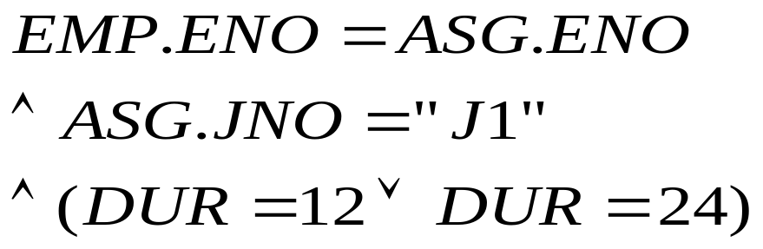
1) Normalization (cont.)
Example
  SELECT ENAME
  FROM EMP, ASG
  WHERE EMP.ENO=ASG.ENO AND ASG.JNO=”J1”
  AND (DUR=12 OR DUR=24)
The conjunctive normal form:

Slide 33
2) Analysis
Objective
  reject type incorrect or semantically incorrect queries.
Type incorrect
  if any of its attribute or relation names is not defined in the global schema;
  if operations are applied to attributes of the wrong type

Slide 34
2) Analysis (cont.)
! Undefined attribute
Type incorrect example
  SELECT E#
  FROM EMP
  WHERE ENAME>200
! Type mismatch

Slide 35
2) Analysis (cont.)
Semantically incorrect
  Components do not contribute in any way to the generation of the result
  For only those queries that do not use disjunction (∨) or negation (¬), semantic correctness can be determined by using query graph

Slide 36
Query Graph
Two kinds of nodes
  One node represents the result relation
  Other nodes represent operand relations
Two types of edges
  an edge to represent a join if neither of its two nodes is the result
  an edge to represent a projection if one of its node is the result node
Nodes and edges may be labeled by predicates for selection, projection, or join.

Slide 37
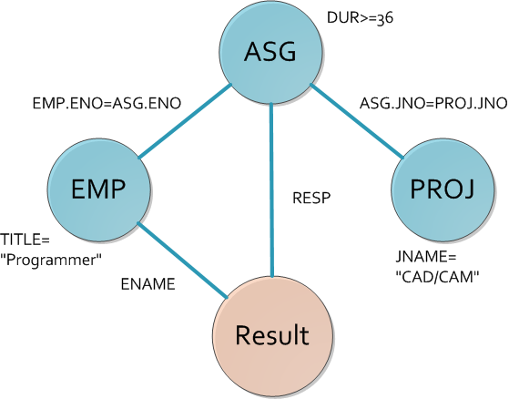
Query Graph Example
SELECT ENAME, RESP
FROM EMP,ASG,PROJ
WHERE EMP.ENO=ASG.GNO
AND ASG.PNO=PROJ.PNO AND PNAME=“CAD/CAM”
AND DUR>36
AND TITLE=“Programmer”

Slide 38
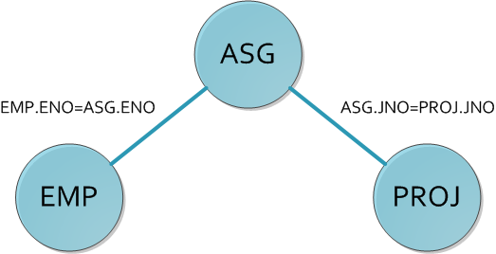
Join Graph Example 1
A subgraph of query graph for join operation.

Slide 39
Tool of Analysis
A conjunctive query without negation is semantically incorrect if its query graph is NOT connected!

Slide 40

Analysis Example

Slide 41
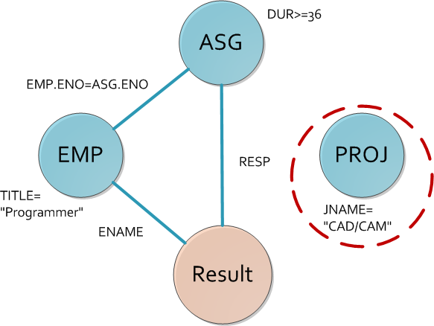
Query Graph Example 2

Slide 42
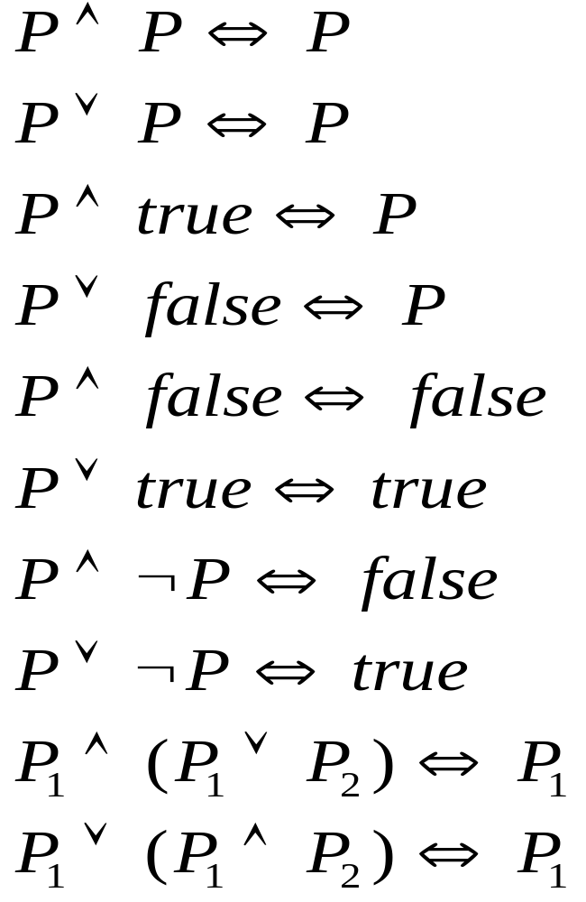
3) Simplification
Using idempotency rules to eliminate redundant predicates from WHERE clause.

Slide 43
Simplification Example
SELECT TITLE
FROM EMP
WHERE (NOT(TITLE=”Programmer)
AND (TITLE=“Programmer”
OR TITLE=“Electrical Eng.”)
AND NOT(TITLE=“Electrical Eng.”))
OR ENAME=“J.Doe”
is equivalent to
SELECT TITLE
FROM EMP
WHERE ENAME="J.Doe"

Slide 44
Simplification Example (cont.)
  p1 = <TITLE = ``Programmer''>
  p2 = <TITLE = ``Elec. Engr''>
  p3 = <ENAME = ``J.Doe''>
Let the query qualification is
(¬ p1 ∧ (p1 ∨ p2) ∧ ¬ p2) ∨ p3
The disjunctive normal form of the query is
= (¬ p1 ∧ p1 ∧ ¬p2) ∨ (¬ p1 ∨ p2 ∧ ¬ p2) ∨ p3
= (false ∧ ¬ p2) ∨ (¬ p1 ∧ false) Ú p3
= false ∨ false ∨ p3
= p3

Slide 45
4) Rewriting
Converting a calculus query in relational algebra
  straightforward transformation from relational calculus to relational algebra
  restructuring relational algebra expression to improve performance
  making use of query trees

Slide 46
Relational Algebra Tree
A tree defined by:
  a root node representing the query result
  leaves representing database relations
  non-leaf nodes representing relations produced by operations
  edges from leaves to root representing the sequences of operations

Slide 47
An SQL Query and Its Query Tree
Π_{ENAME}
σ(ENAME<>“J.DOE” )∧(JNAME=“CAD/CAM” )∧ (Dur=12 ∨ Dur=24)
SELECT Ename
FROM J, G, E
WHERE G.Eno=E.ENo
AND G.JNo = J.JNo
AND ENAME <> `J.Doe'
AND JName = `CAD'
AND (Dur=12 or Dur=24)
_{JNO}
_{ENO}
PROJ
ASG
EMP

Slide 48
How to translate an SQL query into an algebra tree?
  Create a leaf for every relation in the FROM clause
  Create the root as a project operation involving attributes in the SELECT clause
  Create the operation sequence by the predicates and operators in the WHERE clause

Slide 49
Rewriting -- Transformation Rules (I)
Commutativity of binary operations:
  R × S ⇔ S × R
  R ∪ S ⇔ S ∪ R
Associativity of binary operations:
  (R × S) × T ⇔ R × ( S × T )
Idempotence of unary operations: grouping of projections and selections
  Π_{A’} ( Π _{A’’} (R )) ⇔ Π _{A’} (R ) for A’⊆A’’⊆ A
  σ_{p1(A1)} ( σ _{p2(A2)} (R )) ⇔ σ _{p1(A1) ∧p2(A2)} (R )
R S ⇔ S R
(R S) T ⇔ R (S T)

Slide 50
Rewriting -- Transformation Rules (II)
Commuting selection with projection
  Π_{A1, …, An} ( σ _{p (Ap)} (R )) ⇔ Π_{A1, …, An} ( σ _{p (Ap)} ( Π_{A1, …, An, Ap}(R )))
Commuting selection with binary operations
σ _{p (Ai)}(R × S) ⇔ (σ _{p (Ai)}(R)) × S
σ _{p (Ai)}(R S) ⇔ (σ _{p (Ai)}(R)) S
σ _{p (Ai)}(R ∪ S) ⇔ σ _{p (Ai)}(R) ∪ σ _{p (Ai)}(S)
Commuting projection with binary operations
Π_{C}(R × S) ⇔ Π_{A}(R) × Π_{B} (S) C = A ∪ B
Π_{C}(R S) ⇔ Π_{C}(R) Π_{C} (S)
Π_{C} (R ∪ S) ⇔ Π_{C} (R) ∪ Π_{C} (S)

Slide 51
How to use transformation rules to optimize?
Unary operations on the same relation may be grouped to access the same relation once
Unary operations may be commuted with binary operations, so that they may be performed first to reduce the size of intermediate relations
Binary operations may be reordered

Slide 52
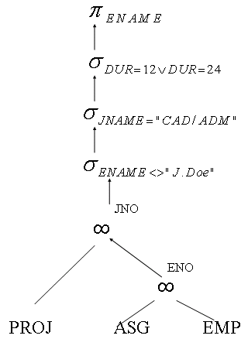
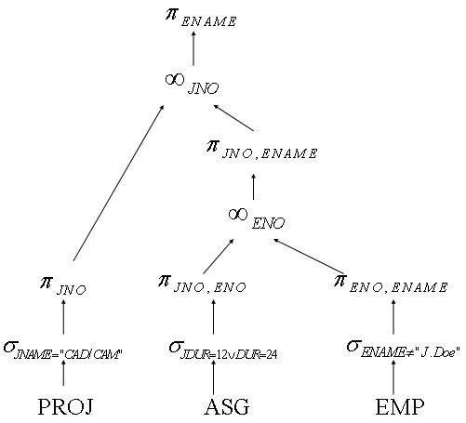
Optimization of Previous Query Tree

Slide 53
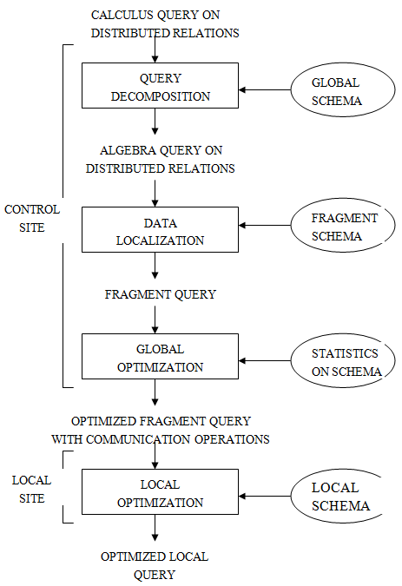
Step 2 : Data
Localization
Task : To translate a query on global relation into algebra queries on physical fragments, and
optimize the query by reduction.

Slide 54
Data Localization-- An Example
EMP is fragmented into
EMP1 = σ_{ENO≤ “E3”} (EMP)
EMP2 = σ _{“E3” < ENO≤ “E6”} (EMP)
EMP3 = σ_{ENO >“E6”} (EMP)
Π_{ENAME}
σ_{Dur=12 ∨ Dur=24}
σ_{ENAME<>“J.DOE”}
ASG is fragmented into
ASG1 = σ_{ENO≤ “E3”} (ASG)
ASG2 = σ_{ENO >“E3”} (ASG)
σ_{JNAME=“CAD/CAM”}
_{JNO}
_{ENO}
PROJ
∪
∪
ASG1
ASG1
ASG2
EMP1
EMP2
EMP3

Slide 55
Reduction with Selection for PHF
SELECT *
FROM EMP
WHERE ENO=“E5”
EMP is fragmented into
EMP1 = σ_{ENO≤ “E3”} (EMP)
EMP2 = σ _{“E3” < ENO≤ “E6”} (EMP)
EMP3 = σ_{ENO >“E6”} (EMP)
Given Relation R, F_{R}={R₁, R₂, …, R_{n}} where R_{j} =σ_{pj}(R)
σ_{pi}(R_{j}) = ∅ if ∀x ∈ R: ¬(p_{i}(x)∧p_{j}(x))
σ_{ENO=“E5”}
σ_{ENO=“E5”}
σ_{ENO=“E5”}
∪
EMP
EMP1
EMP2
EMP3
EMP2

Slide 56
Reduction with Join for PHF
SELECT *
FROM EMP, ASG
WHERE EMP.ENO=ASG.ENO
_{ENO}
∪
∪
_{ENO}
ASG1
ASG1
ASG2
EMP1
EMP2
EMP3
ASG
EMP
EMP is fragmented into
EMP1 = σ_{ENO≤ “E3”} (EMP)
EMP2 = σ _{“E3” < ENO≤ “E6”} (EMP)
EMP3 = σ_{ENO >“E6”} (EMP)
ASG is fragmented into
ASG1 = σ_{ENO≤ “E3”} (ASG)
ASG2 = σ_{ENO >“E3”} (ASG)

Slide 57
Reduction with Join for PHF (I)
_{ENO}
(R1 ∪ R2) S ⇔
(R1 S) ∪ (R2 S)
∪
∪
ASG1
ASG1
ASG2
EMP1
EMP2
EMP3
∪
_{ENO}
_{ENO}
_{ENO}
_{ENO}
_{ENO}
_{ENO}
EMP1
ASG1
EMP1
ASG2
EMP2
ASG1
EMP2
ASG2
EMP3
ASG1
EMP3
ASG2

Slide 58
Reduction with Join for PHF (II)
∪
_{ENO}
_{ENO}
_{ENO}
EMP1
ASG1
EMP2
ASG2
EMP3
ASG2
Given R_{i} =σ_{pi}(R) and R_{j} =σ_{pj}(R)
R_{i} Rj = ∅ if ∀x ∈ R_{i} , ∀y∈ R_{j}: ¬(p_{i}(x)∧p_{j}(y))
Reduction with join
1. Distribute join over union
2. Eliminate unnecessary work

Slide 59
Reduction for VF
Find useless intermediate relations
Relation R defined over attributes A = {A1, A2, …, An} vertically fragmented as R_{i} =Π_{A’} (R) where A’⊆ A
Π_{D} (R_{i}) is useless if the set of projection attributes D is not in A’
EMP1= Π_{ENO,ENAME} (EMP)
EMP2= Π_{ENO,TITLE} (EMP)
Π_{ENAME}
Π_{ENAME}
_{ENO}
SELECT ENAME
FROM EMP
EMP1
EMP2
EMP1

Slide 60
Reduction for DHF
Distribute joins over union
Apply the join reduction for horizontal fragmentation
EMP1: σ_{TITLE=“Programmer”} (EMP)
EMP2: σ_{TITLE≠“Programmer”} (EMP)
ASG1: ASG _{ENO} EMP1
ASG2: ASG _{ENO} EMP2
_{ENO}
σ_{TITLE=“MECH. Eng.”}
∪
∪
SELECT *
FROM EMP, ASG
WHERE ASG.ENO = EMP.ENO
AND EMP.TITLE = “Mech. Eng.”
ASG1
ASG1
ASG2
EMP1
EMP2

Slide 61
Reduction for DHF (II)
Selection first
_{ENO}
Joins over union
σ_{TITLE=“Mech. Eng.”}
∪
ASG1
ASG1
ASG2
EMP2
∪
_{ENO}
_{ENO}
_{ENO}
σ_{TITLE=“Mech. Eng.”}
σ_{TITLE=“Mech. Eng.”}
σ_{TITLE=“Mech. Eng.”}
ASG2
EMP2
ASG1
EMP2
ASG2
EMP2
ASG1
ASG1
ASG1

Slide 62
Reduction for Hybrid Fragmentation
Combines the rules already specified:
  Remove empty relations generated by contradicting selection on horizontal fragments;
  Remove useless relations generated by projections on vertical fragments;
  Distribute joins over unions in order to isolate and remove useless joins.

Slide 63
Reduction for Hybrid Fragmentation - Example
EMP1 = σ_{ENO≤“E4”} (Π_{ENO,ENAME} (EMP))
EMP2 = σ_{ENO>“E4”} (Π_{ENO,ENAME} (EMP))
EMP3 = Π_{ENO,TITLE} (EMP)
QUERY:
SELECT ENAME
FROM EMP
WHERE ENO = “E5”
Π_{ENAME}
σ_{ENO=“E5”}
Π_{ENAME}
EMP2
σ_{ENO=“E5”}
_{ENO}
∪
EMP1
EMP3
ASG1
EMP2

Slide 64
Question & Answer

